Slide 1
Climfoot training session
20-21 April 2016
Energy and climate global challenges
Notes:
What fundamentally back up the calculation of carbon footprint are the major global challenges we are facing regarding energy and climate change.
In that section we’ll briefly cover what are the main challenges and the main messages you’ll have to keep in mind.
If you plan to regularly work on carbon topics, I strongly recommend you to become as expert as possible on those subjects.
If today we are facing major challenges about energy and climate change, this is fundamentally related to two recent changes of orders of magnitude.

Slide 2
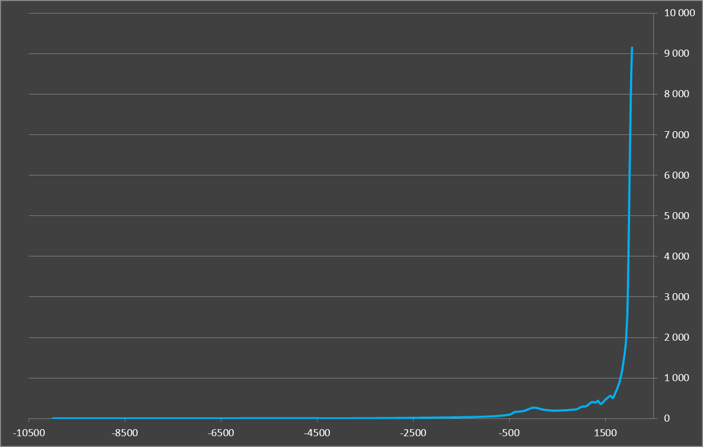
First major global change
We are much more numerous for not a very long time
X 2 in 40 years
X 7 in 200 years
(Sources United Nation and US Census Bureau,
Notes:
The first one is the very rapid growth of the world population, over the last 200 years.
On this slide we can see the evolution of the world population over a very long period (more than 10.000 years). That population grew very very slowly until the 18e century, to reach about a billion people. Since then, thanks to many different progresses, the world population has been multiplied by 7, and it was multiplied by 2 over the last 40 years. This is key to understand many different challenges we are facing today, including those about energy and climate change, as we’ll see in the following slides. Because, to produce food, clothes, houses, transport etc… for 7 billion people has definitively more impact on the environment and natural resources, than when there was only few million people on the planet. In addition, for the next 30 to 40 years, demographist are expecting an additional 2 billion people to « join the team » !
Few comparisons:
There were 5 million people in -10000, which is equivalent to the population of cities such as Madrid (3.4 millions, of London (7.7 Millions)
10.000 years later, ie at the beginning of the current era, there were about 250 million people, which comparable to one large country (Russia 150 million, USA 300 million)

Slide 3
ENERGY
Notes:
Let’s look now more specifically to key challenges we are facing related to energy. Here again, one key starting message to keep in mind is a major change in the order of magnitude.

Slide 4
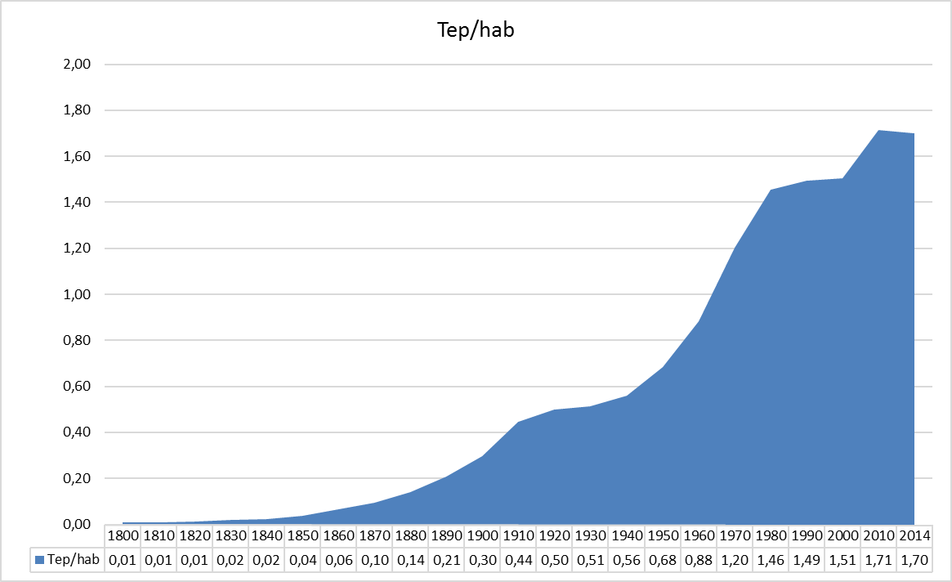
Second major global change
Our individual consumption grew very rapidly over a short period of time
Energy cons. Excep biomass, in Toe per inhabitant
Various Sources
Toe = Ton of Oil Equivalent
1 Toe = 7,3 barrels = 11600 kWh = 1200 m3 natural gas = 3 tons of wood
Notes:
AlternConsult
02/06/06
Présentation Bilan Carbone
4
The second change in the order of magnitude is the evolution of the individual average annual consumption of energy. That is, we take the world annual consumption of energy, and we simply divide it by the total number of inhabitants on the earth.
Then we have about 0,15 Toe per person per annum in 1880. That has been multiplied by more than 10 over a little more than a century to reach 1,7 Toe in the current period.
Please note that data here are expressed in Toe, which represents the quantity of heat you can get from burning 1 ton of oil. This is an energy unit commonly used in the statistics. If you are not familiar with that unit, you might be more familiar with an other unit such as kWh, or m3 (for natural gas) for example. As we’ll see later, when we do carbon footprint calculation, a lot has to do with energy, and having a minimum knowledge of energy unit will be helpful to you.
We can also highlight on this chart that the growth has been particularly strong during the 1945 – 1975 period.
Keep also in mind that these data are a world average. The value for individuals in richest countries is between 3 to 6 times higher than that.

Slide 5
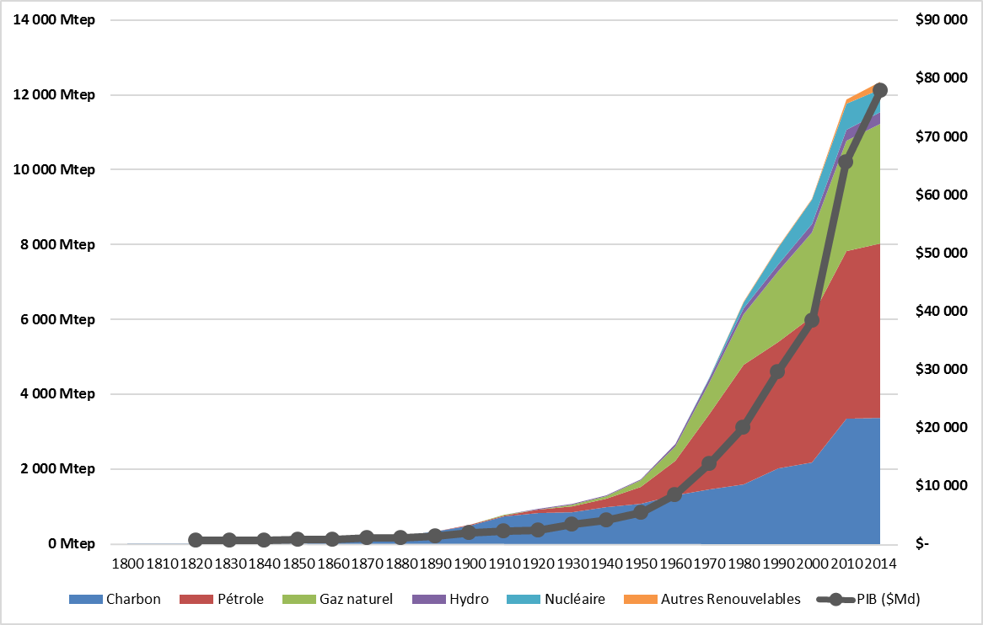
World energy consumption exploded… and world GNP too.
World consumption in MToe (millions of tons of oil equivalent) since 1850. (Source TSP Database)
GNP in $billions since 1820. (Sources : Angus Maddison)
Notes:
5
If we combine the 2 previous charts and data : 7 times more people and each individual consuming 10 times more energy, gives us an explosion of the world energy consumption : a multiplication by more than 70 over just 150 years or so.
That is represented of this chart, where we also have the breakdown of that consumption across the different energy sources. Dark blue is for coal, red is for oil, green is for gas, purple is for hydro, light blue for nuclear and yellow for the other renewables. We can make few comments here :
First over time, the different resources have been used one after the other. First coal, then oil, then gas etc… However, the growing consumption of one particular resource did not mean a decrease of the previously used ones. We just added resources one to the other.
Second more than 90% of our current consumption is based on fossil resources (and I also consider in that category uranium for nuclear). And by definition those resources are not renewable, at least at human time scale. In about 100 million years there will be new oil available. We just need to wait…
In parallel, as it’s illustrated on this chart, during the same period, the world GDP followed the same trend, and that is normal. Can you tell me why ?
Very simply explained, all our economic activity does one thing : it transform something from one initial stage to another stage. And that transformation is done to generate value. But from a physical standpoint, when you transform something from stage 1 to stage 3 you need energy. Always. And if you can access huge quantity of energy resources very easily and very cheap, therefore you can transform more and more things, and then generate more and more financial value.

