Slide 1

Climfoot training session
20-21 April 2016
Methodological principles

Slide 2
Agenda
How can we compare GHGs?
The concept of emission factors
Notes:
ADEME Formation - Edition 2007
BILAN CARBONE
2
In order to calculate GHG emissions of an organisation, with whatever calculation tool, we need two fundamental components :
First we need a common unit that will allow to both compare and aggregate different gases in a meaningful way. We’ll see first how, such a common unit has been defined.
Then we’ll need what will actually help to convert activity data generally expressed in physical units (tons, km, kWh etc…), into their equivalent in carbon emissions. This is what we call emission factors.
OK so let’s start with the first point.

Slide 3
World annual emissions of GHG
World annual emissions in tons, breakdown by categories of gas, except ozone (IPCC, 2007)
How can we evaluate the respective contribution of each gas in terms of radiative forcing?
Notes:
ADEME Formation - Edition 2007
BILAN CARBONE
3
If we consider the annual world emissions of GHG, expressed simply in tons, we get a chart that would look like this one. As such CO2 in total (from fossil fuel combustion and from deforestation), represents about 97% of the total. For the others, less than 3% are for CH4, and all the others have a very small share.
However, when we consider GHG, what is important is not so much how many tons have been emitted, but what will be the impact of the global climate system, through their impact on the strengthening of the greenhouse effect. To do so, we need to consider other aspects of those gas, such as some of their specific physical properties.

Slide 4
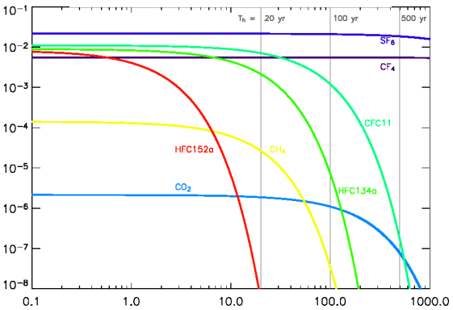
Analysis of the radiative forcing of GHGs
These curves reflect the duration of residence of gases in the atmosphere, which is sometimes going to evolve in the future (in particular for the CO₂)
Radiative forcing over time of a ton of gas emitted at the moment 0
(horizontal axis: in years - logarithmic scale; vertical axis: radiative forcing in W / m2 - Logarithmic scale)
Source : D. Hauglustaine, LSCE
Notes:
ADEME Formation - Edition 2007
BILAN CARBONE
4
The two main aspects that are considered are represented on this chart.
The first one, is the time one given volume of gas will stay in the atmosphere. Depending on their respective chemical properties, GHGs are more or less stable, and the more stable they are the longer they stay in the atmosphere. This is represented on this chart with the horizontal axis which represent time in years (but be careful of the logarithmic scale).
The second one is what we call the radiative forcing, which represent the quantity of additional energy the given volume of GHG will contribute to add to the atmosphere. This parameter is expressed in Watt per m². On this chart this is represented with the vertical axis, which is also an logarithmic scale.
The combination of those 2 aspects enable to define one common unit for the various gases. Actually there are other factors considered, but those are the most important ones.

Slide 5
The comparison unit: the Global Warming Potential
A relatively complex equation, but quite easy to understand!
The Global Warming Potential means how many times the CO₂ ?
Notes:
ADEME Formation - Edition 2007
BILAN CARBONE
5
This common unit is call the global warming potential, or GWP.
The GWP is always defined relatively to a time period. One can define a GWP for a 10, or 20, or 50 or 100 year period. This is a conventional choice. As we’ll see later, so far the GWP-100 is the unit that is used for all GHG emission calculation.
GWP is not defined in absolute terms, but relatively to CO2. Actually this means : over a given period (from 0 to N), we calculate the sum of radiative forcing for one gas, and we compare it to the sum of the radiative forcing of the CO2 over the same period. Therefore, defining the GWP, is equivalent to defining how much time the CO2, one gas represent in terms of additional energy.

Slide 6
GWP in practice
GWP is an indicator that is approximate but which enable to take actions
(IPCC, 2013)
GWP = CO₂ equivalent
Notes:
ADEME Formation - Edition 2007
BILAN CARBONE
6
Then, when we apply what we’ve just said, that gives us, a table of the GWP for the different GHGs.
Obviously, GWP of CO2 always equal to 1, but then, over a 100 year period, CH4 has a GWP between 28 and 30. That means that if I release 1 ton of CH4, over 100 years, it will impact the climate system as much as if I had released 28 to 30 tons of CO2. And same explanation for the others.

Slide 7
Therefore …
For all human GHG emissions calculations
- We use GWP 100 (or CO2 equivalent).
- We do not take water vapor into account
(low resident time in the atmosphere, and no increase of the discernible concentration resulting from emissions)
- We do not take ozone into account.
(no direct emissions, short live gas, and impossible to calculate indirect emission with a simple rule).
Notes:
ADEME Formation - Edition 2007
BILAN CARBONE
7

Slide 8
So counting GHGs…
An intrinsically approximate exercise because of the uncertainties of physical nature
Reasoning in order of magnitude
Results in order of magnitude
Notes:
ADEME Formation - Edition 2007
BILAN CARBONE
8

Slide 9
Thanks to the common unit (GWP), we can compare GHG gases
World emission by gas, in tons of CO2 equivalent (except ozone)
(Jancovici, 2007, data from IPCC 2007 - CH₄ and N₂O are counted with their GWP 2007)
Notes:
ADEME Formation - Edition 2007
BILAN CARBONE
9

